Slide 1


01
Business Problem
Content
02
Business Goals
03
04
Platform Components
Reference Architecture
05
Options & Considerations
06
Outcome

Slide 2


Business Problem
Our data tools and governance need modernizing to keep pace with growing analytics needs and control costs. This submission seeks TAG approval to run a proof of concept of Microsoft Fabric under project P0905.
❯ What’s not working today
Ageing platform – our data tools and governance aren’t built for modern, cloud-based analytics.
Higher costs than needed – reporting and web analytics run on older, more expensive technology.
Readiness gaps – today’s environment and access controls aren’t yet set up to support the new platform.
❯ Risk to the corporation
The new platform would handle sensitive member data, so the right security, privacy, and access controls must be in place before we move beyond a pilot (risk owner: Cristina Stepanov).
❯ How we’re managing it
Testing safely in an isolated environment using non-identifiable data, with security and governance teams involved from the start.
❯ Who’s impacted
IT Engineering, IT Services, the Power Platform team, Business Analytics, Digital Communications, and IT Security.

Slide 3
Business Goals
Supports our Plan 20|30 Wave 2 goals to strengthen efficiency and quality – modernizing technology, reducing outside dependencies, lowering costs, and improving data security and analytics.
❯ What we want to achieve
Modernize – move to a modern, cloud-based data platform.
Simplify and consolidate – improve how data and reporting are delivered and remove duplicate tools.
Lower costs – reduce technology and support costs while maintaining service levels.
❯ How we’ll measure success
A working trial of the new platform with the right security and governance in place, ending in a clear recommendation to leadership.
❯ Program area and funding
Delivered and funded under project P0905 (IT Engineering), within the approved Wave 2 budget.

Slide 4


Platform Components
W H A T A F A B R I C I M P L E M E N T A T I O N N E E D S
Platform & storage | Ingest & transform | Serve & consume
Fabric capacity (F SKU) Workspaces Domains OneLake Lakehouse Warehouse (where T-SQL write is needed) Shortcuts | Data pipelines Copy Job Dataflow Gen2 Spark notebooks Mirroring Event / file triggers Configuration store | SQL analytics endpoint Semantic models Direct Lake Power BI reports Published apps
Identity & access | Connectivity | Govern & operate
Entra ID security groups Conditional Access Privileged Identity Management Service principals / managed identities Workspace roles Item permissions OneLake row & column security, masking | VNet data gateway On-premises data gateway Private endpoints / Private Link ExpressRoute Key Vault for connection secrets | Git integration Deployment pipelines Lineage OneLake catalog & endorsement Sensitivity labels Audit logs Capacity Metrics app Purview · Sentinel (optional)
Every component above forms part of a Fabric implementation. Which are used, and how they are configured, follows from the sources and requirements in scope — the options at each point are set out on the following slides.

Slide 5
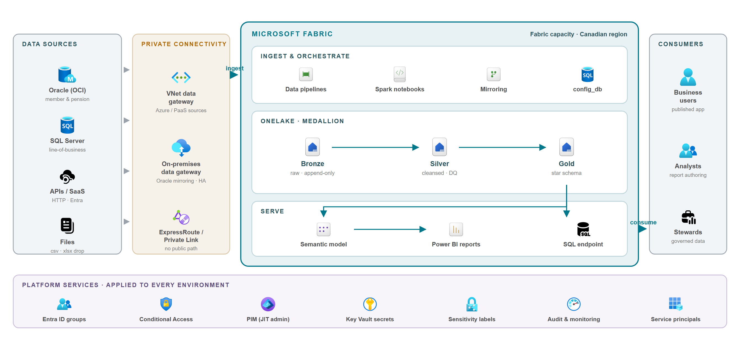
Reference Architecture
C O M P O N E N T S A N D H O W T H E Y F I T

Slide 6
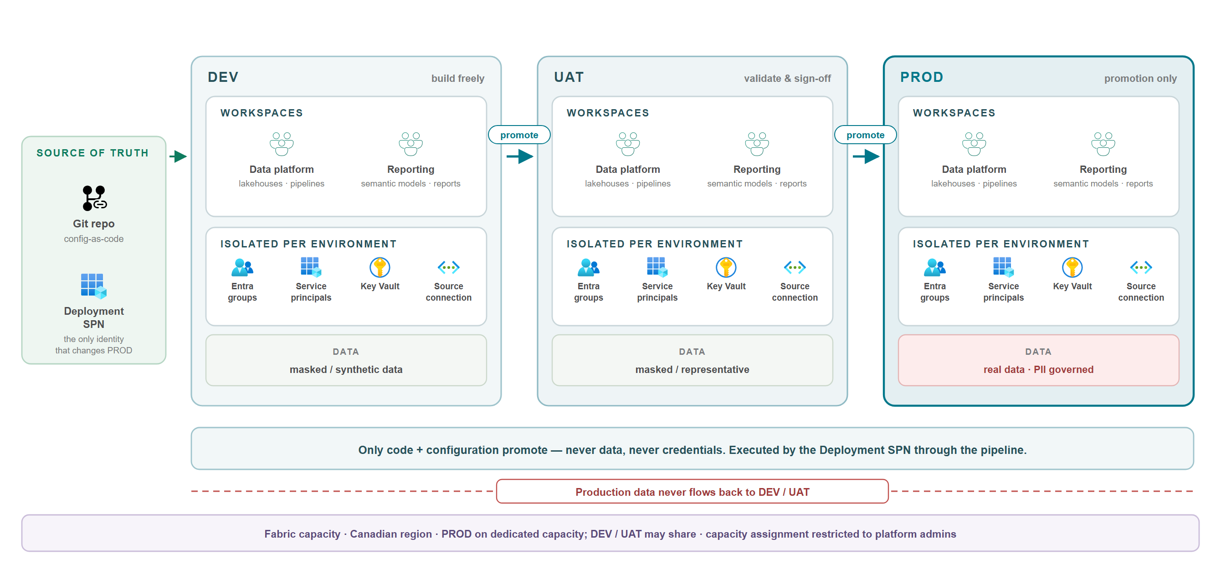
Workspace & Environments
E N V I R O N M E N T S A N D D E P L O Y M E N T

Slide 7
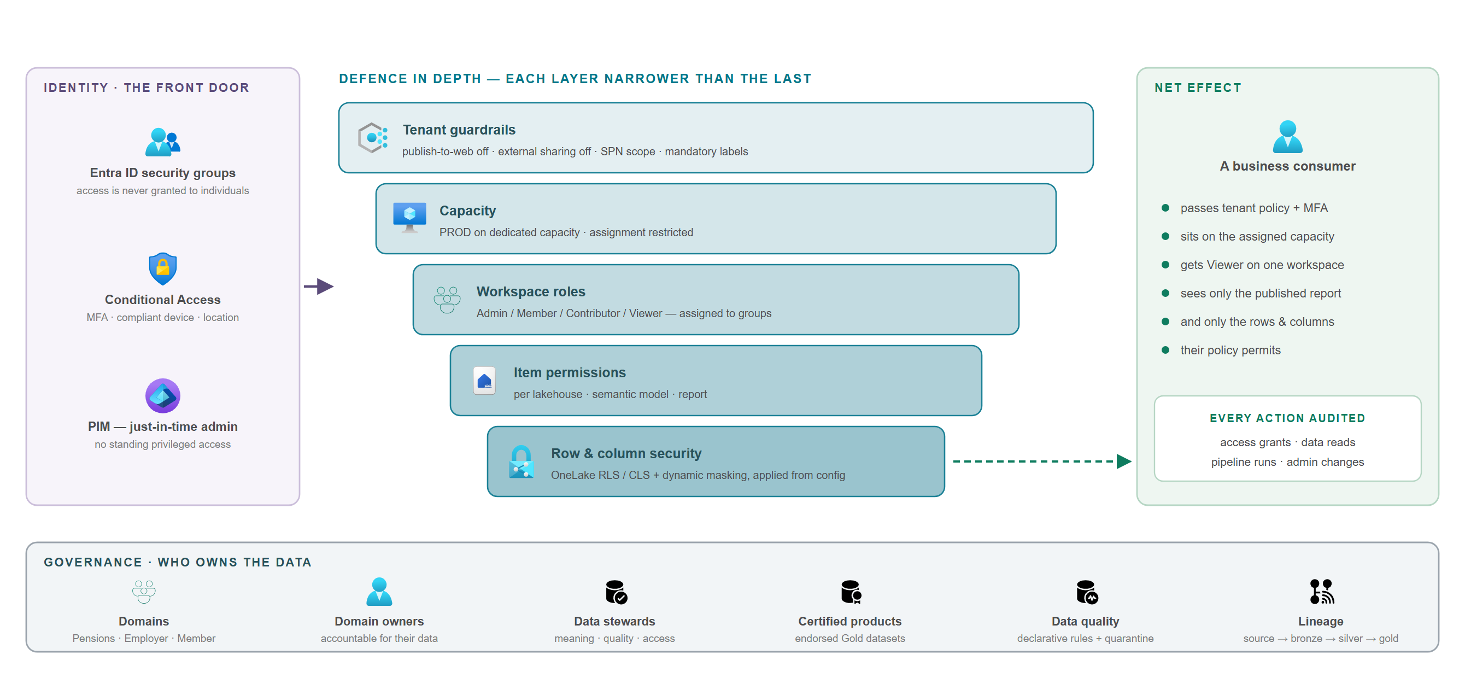
Security, Access & Governance
I D E N T I T Y , A C C E S S A N D D A T A P R O T E C T I O N

Slide 8
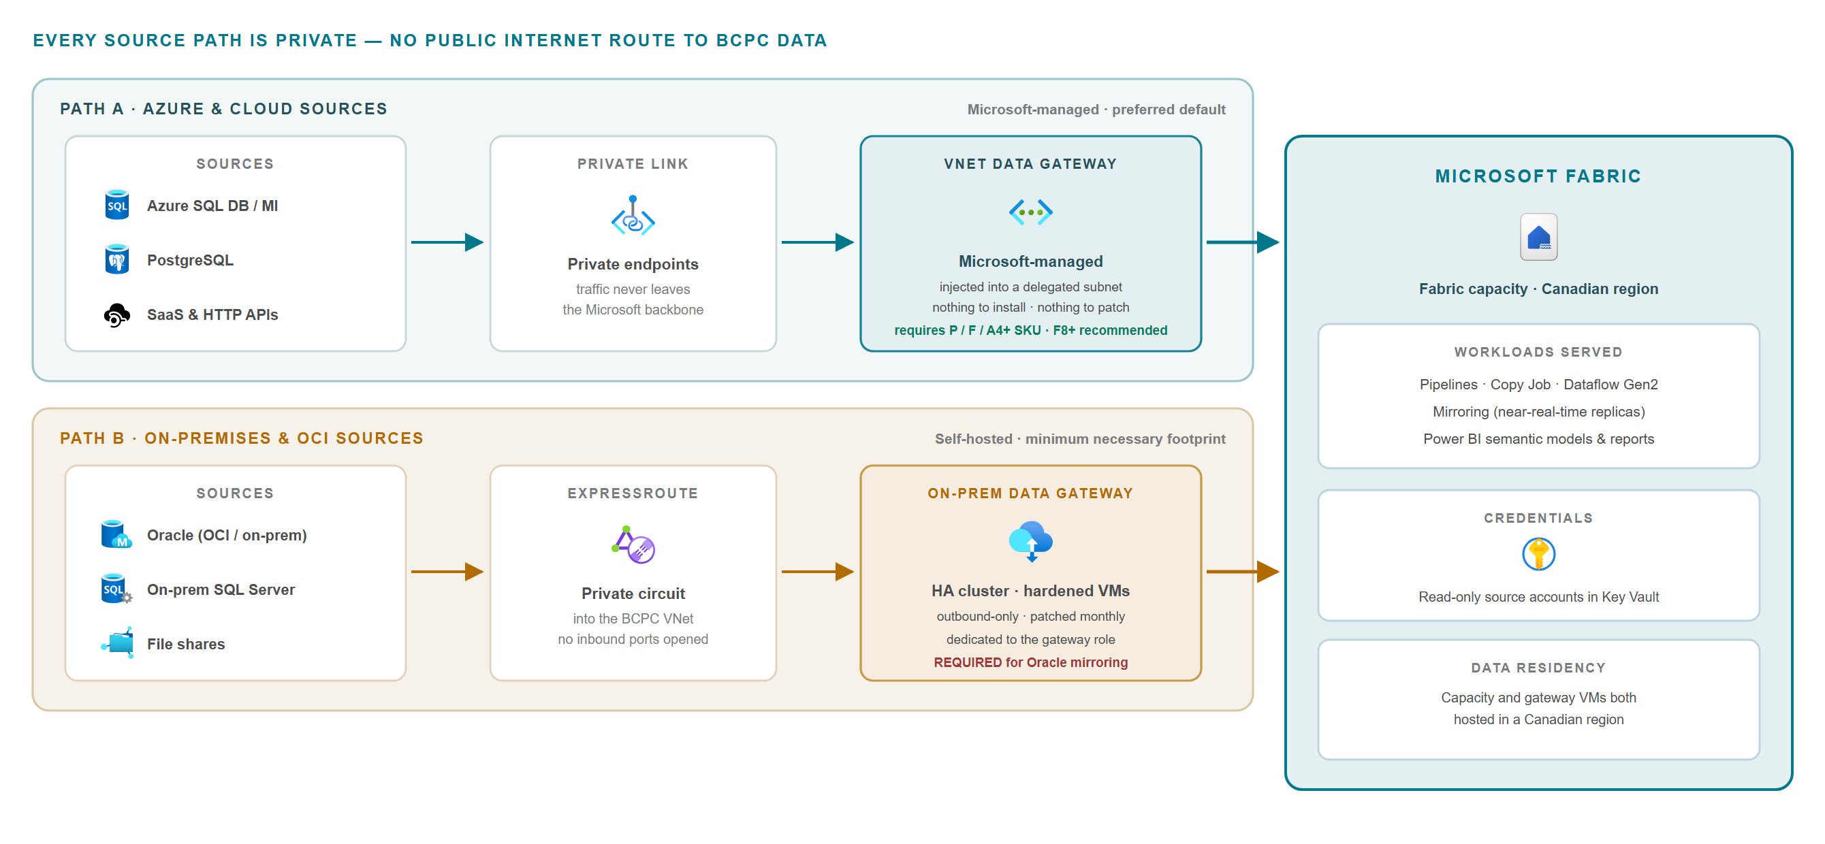
Connectivity & Gateway
P R I V A T E P A T H S F R O M S O U R C E T O F A B R I C

Slide 9
Component Options
W H E R E T H E R E I S A C H O I C E
Storage & modelling | Lakehouse (Spark, Python) or Warehouse (T-SQL write) — both read the same OneLake storage, so this is a question of engine and skills, not of copies.
Ingestion | Mirroring for near-real-time replication · pipelines and Copy Job for batch · Dataflow Gen2 for low-code shaping · shortcuts to reference data in place without copying · event and file triggers for drop-based loads.
Mirroring source support | Oracle requires the on-premises data gateway — the VNet gateway is not an option. SQL Server, Snowflake and Azure SQL accept either gateway; PostgreSQL uses the VNet gateway; Cosmos DB, Fabric SQL DB and open mirroring need none.
Gateway | VNet data gateway is Microsoft-managed with nothing to install; the on-premises gateway is self-hosted and clustered. Which applies follows from where the source sits. The VNet gateway requires a P / F / A4+ capacity, F8 or above.
Environments | Separate workspaces per environment, each with its own identities, secrets and source connections — optionally on separate capacities where isolation of performance or billing is wanted.
Access | Granted to Entra security groups rather than individuals, narrowing through workspace roles, item permissions and OneLake row / column security and masking.
Governance tooling | Fabric's built-in catalog, lineage, endorsement and labels cover the platform. Purview and Sentinel extend governance beyond Fabric, when scope demands.

Slide 10
Implementation Considerations
W H A T S H A P E S T H E B U I L D
Consideration | What it means for the build
Sensitive data | Row and column security and masking are applied from configuration and enforced across engines — but they bind only non-privileged users. Workspace admins, members and contributors read all data regardless, so privileged membership is the real control.
Privileged access | Production change access is best held by a deployment identity rather than people, with administrator roles elevated just in time. This shapes how workspaces and identities are laid out from the start.
Source prerequisites | Mirroring places requirements on the source: Oracle needs LogMiner, archive log mode, supplemental logging and a broad grant set; SQL Server uses change data capture. These are database-side commitments, not Fabric configuration.
Capacity behaviour | Capacity is the shared resource behind every workload. Surge protection, throttling guardrails and Capacity Metrics monitoring determine whether one workload can affect another; separate capacities buy isolation at additional cost.
Workspace and content sprawl | Workspace creation, capacity assignment and item endorsement are tenant-level controls. Left open, the estate fragments; restricted to a request process and provisioned from code, it stays consistent.
Skills and operating model | Configuration-driven onboarding keeps effort per source small, but the platform still needs named owners for capacity, domains and data products, and a promotion path that people follow.

Slide 11
Architecture Principles
One copy of the data | OneLake holds a single copy. Warehouses, semantic models and the SQL endpoint read the same storage, and shortcuts reference data in place rather than duplicating it.
Environments are hard boundaries | Each environment carries its own workspaces, identities, secrets and source connections. Only code and configuration promote between them — never data, never credentials.
Access narrows layer by layer | Entra groups, then workspace roles, then item permissions, then row and column security and masking — each layer narrower than the last, and granted to groups, not individuals.
Private connectivity on every path | The managed VNet data gateway as the default, with a small hardened on-premises gateway cluster only where Microsoft requires it. No public-internet route to BCPC data.
Configuration over bespoke build | Sources, quality rules, models and security policies declared as configuration in git, so onboarding a source is a config change and every environment is provisioned identically.
7

Slide 12
Outcome
T A G A P P R O V A L S
Presented by: | <Name, Business Unit>/ <Name, Business Unit>
Date: | Jan 23, 2025
Outcome: | Approved / Rejected / Follow Up Required
Comments: | PIA Required – Yes or No STRA Required – Yes or No AI Assessment Required – Yes or No
AIMS Representative (Chair) | Ramesh Dondapati/ Mark O’Regan
ITE Representative | Cristina Stepanov
ITSO Representative | Calin Somosan
ITBS Representative | Cheryl Stewart
PPMO Representative | Rajkumar Easwaran
8

Slide 13

Appendix
bcpensioncorp.ca
9

